Slide 1

The danger of ransomware for organizations
Prevention, protection and response
Nicolás D'Alessandro Calderon
Network and System Administration
Universitat Oberta de Catalunya, 2025

Slide 2



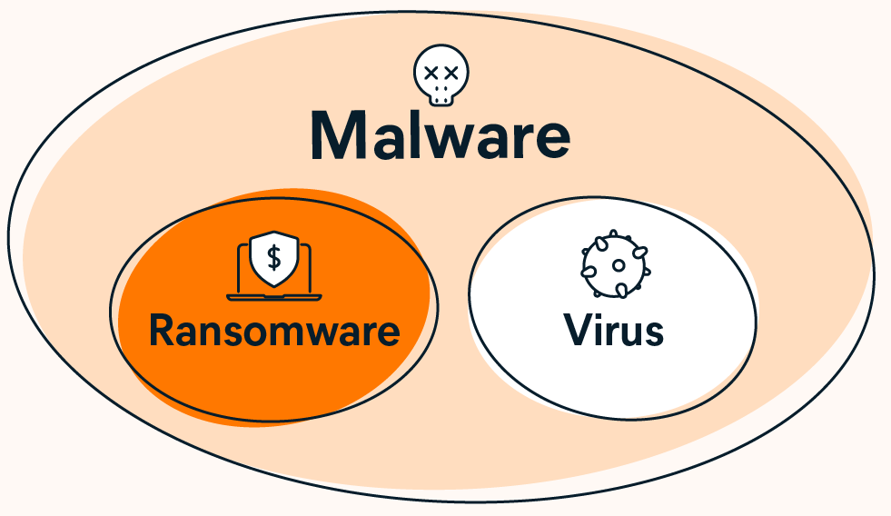
1. What is ransomware?
Malware that encrypts or locks systems and data.
Demands payment to gain access.
Affects all types of organizations.

Slide 3
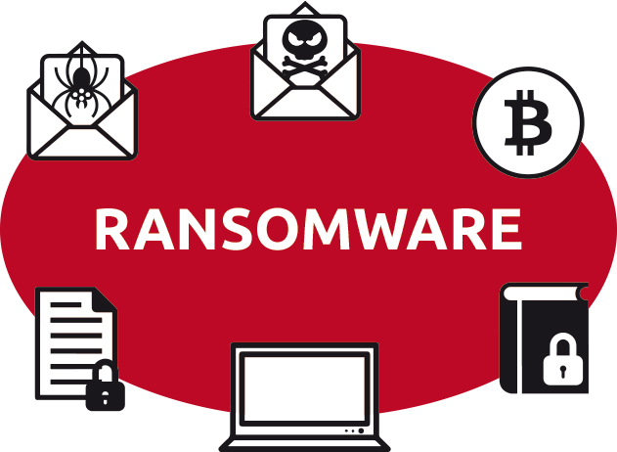

2. Types of ransomware
File Encryption
Ransomware locks your files so you can’t open them.
Full System Lockout
You lose access to your whole computer or network.
Double Extortion
Attackers steal your data and lock it to ask for more money.
Famous cases: CryptoLocker, WannaCry, Ryuk

Slide 4

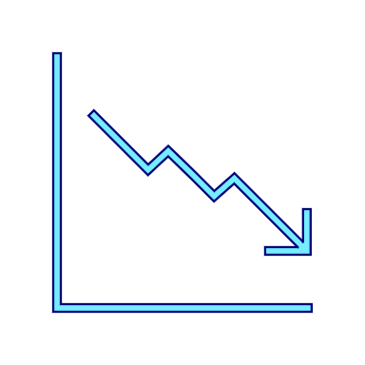

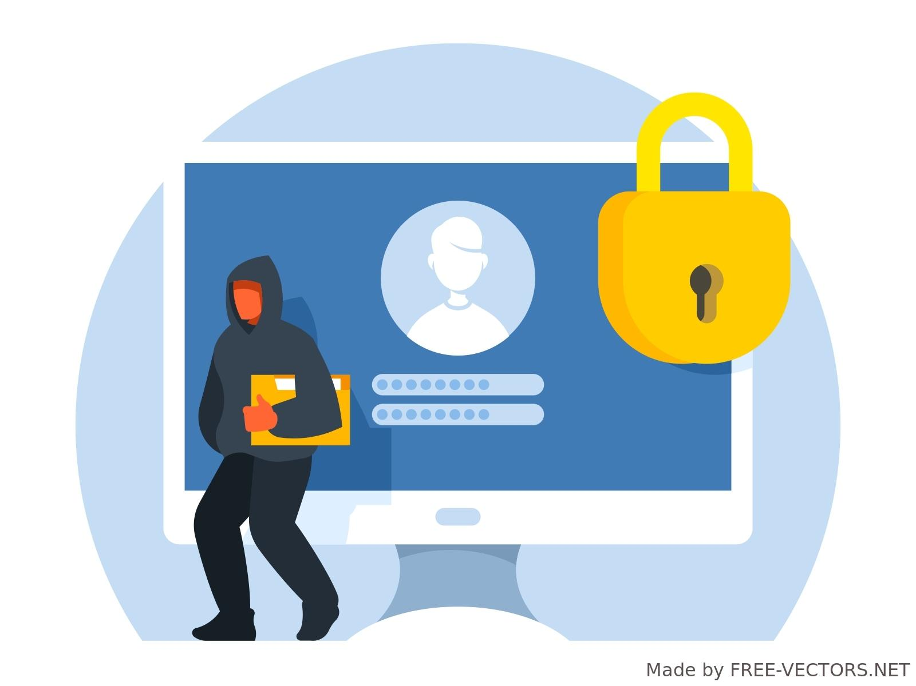
3. Impact and consequences
Major financial losses
Reputational damage to companies
Legal sanctions if confidential data is leaked
Around 60% of organizations suffered attacks

Slide 5
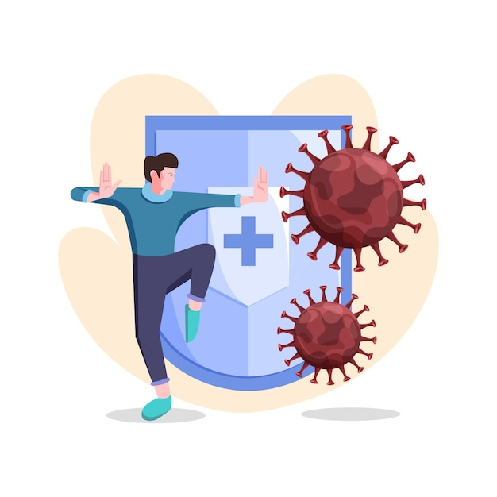

4.1 Prevention: Organizational Policies
Least Privilege Access
Give each user only the access they really need to do their job.
Regular Patching and Updates
Keep systems and software updated to fix known problems.
Use of Frameworks like NIST or ISO 27001
Follow trusted guides to improve security and show good practices.
Breaking the network into parts makes it harder for attackers to move and limits the damage.

Slide 6




4.2 Prevention: Awareness
Ongoing Training
Phishing Simulations and Campaigns
Reporting Culture
Support from Management
Many attacks begin with human error. Investing in training is more cost-effective than suffering operational outages.

Slide 7
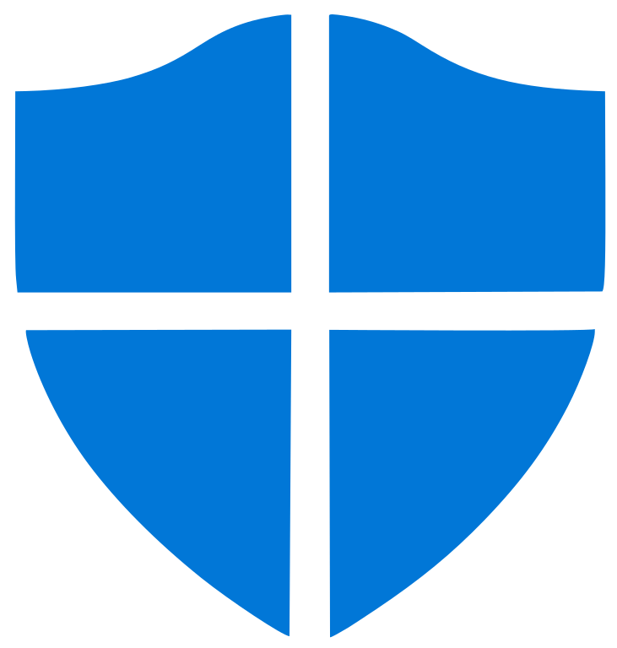
5. Active protection
Suspicious Activity Detection (EDR/XDR)
These tools watch computers and servers. They can find strange actions like many files being locked or attackers moving inside the system.
Network Monitoring (NDR)
This tool watches the network traffic. It can find unusual movements, like ransomware spreading or data being stolen.
Immutable Backups
Backups that cannot be changed or deleted for a certain time. Even if ransomware attacks, the backup stays safe.
A coordinated protection system isolates compromised systems in minutes, before ransomware can spread.

Slide 8
6. Response to Incidents
Detection and Analysis
Containment, Eradication and Recovery
Post/Incident
Activity
Preparation

Slide 9

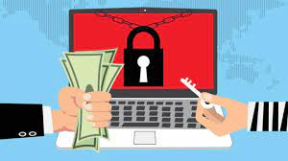
7. Ransom Payment
No guarantees
Funds crime and motivates new attacks
Legal risks
Organizations such as the FBI, CISA and ENISA advise against this practice.

Slide 10
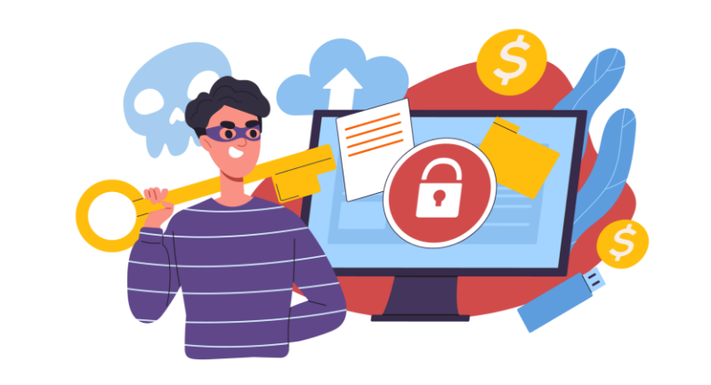
8. Current Solutions Available in the Market
Endpoint protection:
Microsoft Defender, Sophos
Orchestration:
Splunk, QRadar, Microsoft Sentinel
Backup:
Veeam, Commvault, Acronis
Open source:
Wazuh, Zeek, Bacula

Slide 11
Thanks!
Nicolás D'Alessandro Calderon
Network and System Administration
Universitat Oberta de Catalunya, 2025

